Slide 1
FTC Autonomous Mode Using Vuforia
Nex+Gen Griffin Robotics FTC Team 7582
Charles Stallings, Violet Frazier, Cameron Pase
Douglas Pase, dmpase@gmail.com

Slide 2
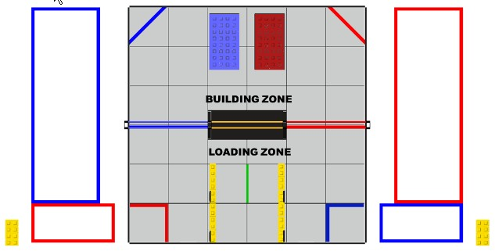
FTC SkyStone Play Field
https://firstinspiresst01.blob.core.windows.net/ftc/2020/gbrm-pt-2.pdf

Slide 3
Match Requirements for Robot Placement
4.5.1 Pre-Match
Drive Teams must place their Robots, in any orientation, touching the Playing Field Wall adjacent to their Alliance’s Driver Station.
A Robot may not contact another Robot.
A Robot may not start in the Depot.
FIRST®Tech Challenge Game Manual Part 2, Section 4.5.1, Page 13

Slide 4
Collision Avoidance Strategies
Strategy A
Front robot takes inside track, delivers front SkyStone, moves Foundation
Rear robot takes outside track, delivers rear SkyStone
Strategy B
Front robot takes outside track, delivers front SkyStone, moves Foundation
Rear robot takes inside track, delivers rear SkyStone

Slide 5
Top Level Autonomous Program Steps
Initialize Robot components
Wait for activation and start timer
Identify the location of the robot
Possible values: Blue Forward, Blue Rear, Red Forward, Red Rear, Unknown
Select action sequence: BF, BR, RF, RR, UNK
Execute selected action sequence
Shut down Robot components

Slide 6
Blue Forward High Level Action Sequence
Locate/identify both forward (left) and rear (right) SkyStones
Select the forward (leftmost) SkyStone and move to the selected SkyStone
Grasp and lift the SkyStone
Move into the Building Zone
Robot turns to port to orient the SkyStone forward, phone facing front/back
Bridge Marker stays to starboard
Robot stays within a pre-selected corridor defined by distance/angle to bridge marker
Move to a pre-determined location where the Foundation should be
Robot may use dead reckoning
Or, Robot may use distance/angle to rear bridge marker
Deliver the SkyStone to the Foundation
Move to the left side of the Foundation
Release the hook and pull the Foundation into position
Raise the hook to release the Foundation

Slide 7
Blue Rear High-Level Action Sequence
Locate/identify both forward (left) and rear (right) SkyStones
Select the rear (rightmost) SkyStone
Move to the selected SkyStone
Grasp and lift the SkyStone
Move into the Building Zone
Bridge Marker stays to the starboard side of the Robot
Robot stays within a pre-selected corridor defined by distance/angle to bridge marker
Move to a pre-determined location where the Foundation should be
Robot may use dead reckoning
Or, Robot may use distance/angle to the rear bridge marker
Deliver the SkyStone to the Foundation

Slide 8
Red Forward High-Level Action Sequence
Locate/identify both forward (right) and rear (left) SkyStones
Select the forward (rightmost) SkyStone move to the selected SkyStone
Grasp and lift the SkyStone
Move into the Building Zone
Robot turns to starboard to orient the SkyStone forward, phone facing front/back
Bridge Marker stays to starboard
Robot stays within a pre-selected corridor defined by distance/angle to bridge marker
Move to a pre-determined location where the Foundation should be
Robot may use dead reckoning
Or, Robot may use distance/angle to rear bridge marker
Deliver the SkyStone to the Foundation
Move to the left side of the Foundation
Release the hook and pull the Foundation into position
Raise the hook to release the Foundation

Slide 9
Red Rear High-Level Action Sequence
Locate/identify both forward (right) and rear (left) SkyStones
Select the rear (leftmost) SkyStone
Move to the selected SkyStone
Grasp and lift the SkyStone
Move into the Building Zone
Bridge Marker stays to the port side of the Robot
Robot stays within a pre-selected corridor defined by distance/angle to bridge marker
Move to a pre-determined location where the Foundation should be
Robot may use dead reckoning
Or, Robot may use distance/angle to the rear bridge marker
Deliver the SkyStone to the Foundation

Slide 10
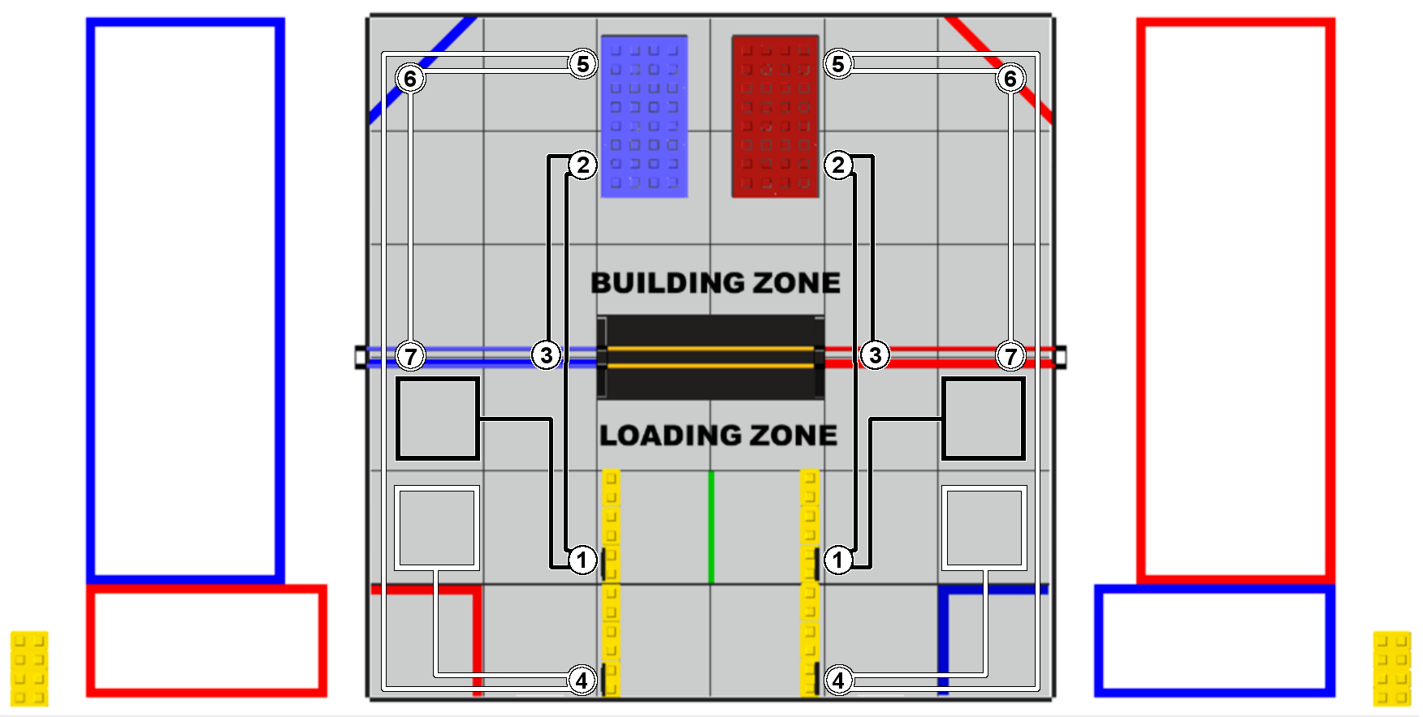
SkyStone Play Field
https://www.reddit.com/r/FTC/comments/d1m6bs/safe_autonomous_paths_for_skystone/

Slide 11
Team 16471 Autonomous Strategy
These sample routes achieve all the goals of this year’s autonomous period while avoiding potential collisions between alliance partners and opposing teams. Before the match, the teams will have to decide who’s going to move the foundation in autonomous. For the purposes of this demonstration, we’ll refer to the team not moving the foundation as Team 1, and the other as Team 2. Finally, here’s a description of the points shown on the diagram:
Team 1 moves over to their quarry and loads the Skystone onto their robot.
Team 1 drives over to their alliance’s foundation and places the Skystone.
Finally, Team 1 navigates to the Skybridge and parks.
Team 2 moves over to their quarry and loads the Skystone onto their robot.
Team 2 drives over to their alliance’s foundation and places the Skystone.
Team 2 then moves the foundation over into their building site.
Finally, Team 2 navigates to the Skybridge and parks.
This strategy yields a total of 48 points for each alliance for completing the following tasks:
Delivering 2 Skystones (20 points)
Placing 2 Stones onto the alliance foundation (8 points)
Repositioning the foundation (10 points)
Navigating to the Skybridge (10 points)

Slide 12
Questions Or Comments?

